Slide 1
Smart Guide: A smart campus guide using BLE based indoor localization

Slide 2
Group Members:
Rida Mahmood (2016-CE-54)
Tooba Naseer (2016-CE-72)
Rabeya Hamood (2016-CE-81)
Ayesha Jabbar (2016-CS-159)
Supervisor:
Dr. Sheikh Faisal Rasheed
Computer Engineering Department, UET Lahore.

Slide 3
Introduction
Predict room level location using BLE beacons.
RSSI fingerprinting technique.
Information of current and its nearby locations on user’s mobile app.
To provide guided tour of the indoor building (CSE Dept of UET).

Slide 4
Problem Statement
?
Whenever a visitor goes to university campus or visits a new place, he does not know about the specifications of that area i.e. what happens in that specific room or what courses have been taught in a particular and its nearby labs. So, we are developing a system which assists them in determining the textual and pictorial information of a particular area and its nearby locations. For this purpose, we first find the indoor location of a user by using BLE beacons and FP values, and then provide information to him automatically on his android application.

Slide 5
Objective
Our objective is to provide ease and guidance to users regarding current and nearby locations automatically via installed application on device by estimating his indoor location. The guidance involves the textual and pictorial information.

Slide 6
Courses
Databases: Database design, normalization
Mobile Application Development: Data Capturing, Admin, User Applications
Software Engineering: SDLC(Agile model to proceed our FYP)
AI and Machine Learning: Algorithms to train a machine learning model
Programming Fundamentals: Coding concepts

Slide 7
Innovation and Design Format
Implement a system that provide ease and guidance facility to university campus visitors based on indoor location.
Using a best technology for the prediction of indoor location as compared to existing technologies by considering performance metrics(accuracy, responsiveness, cost and complexity).
Gathered real World data which we will make publicly available
Hierarchy based Binary Classifier
Data captured at different times for better accuracy of model

Slide 8
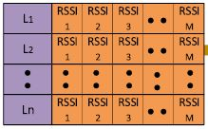
Design Format
BLE- based Fingerprinting Technique

Slide 9

Relation to Mathematical Equations
BLE- based Fingerprinting Technique
Machine Learning
Parameters Tuning for k-NN and Random Forest
Selected Approach: Random Forest
Random forest
For each decision tree, Scikit-learn calculates a nodes importance, assuming only two child nodes and then calculates the importance of each feature.

Slide 10
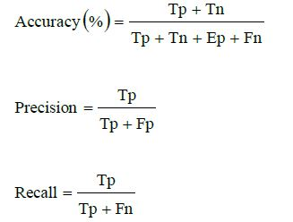
Relation to Mathematical Equations
Machine Learning Phases:
Dataset Pre-Processing
Training Phase and Testing
Phase
Performance Evaluation Metrics

Slide 11
Completed Modules
Dummy application
Collect information of experimental area
Data capturing application
Frontend and backend of Admin Application
Frontend of User Application
Data(FP) collection in CS dept building, UET Lahore.
Train model on that dataset using machine learning models.
Incomplete Modules
User Application backend code
Algorithm design to train model
System Testing

Slide 12
Thanks!

